Slide 1
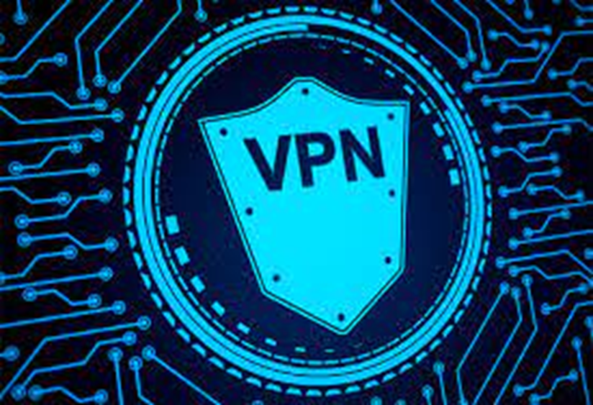
VPN IMPLEMENTATION
Computer Networks CT4 Component: Mini Project
Group Members:
Haripreeth Dwarakanath Avarur [RA2011003010011]
Shruthi Kannan [RA2011003010037]
Gajullapalli Naga Vyshnavi [RA2011003010049]
Aryan Sinha [RA2011003010066]

Slide 2
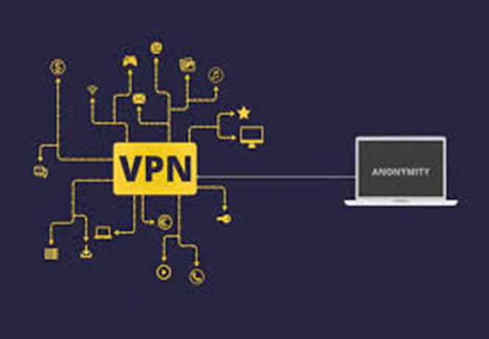
TABLE OF CONTENTS
Abstract
Introduction
Working off a VPN
Configuration of VPN (Procedure)
Implementation of VPN in Cisco Packet Tracer
Applications of VPN
Limitations of VPN
Conclusion
Bibliography

Slide 3
ABSTRACT
A Virtual Private Network (VPN) is a network that is used to create a private scope of computer communications or to provide a secure extension of a private network over an insecure network such as the Internet.
IP Sec or Secure Socket Layer can be used to build a VPN (SSL). These are two fundamentally distinct approaches to VPN development
In our work, we concentrated on SSL-based VPNs, sometimes known as SSL VPNs. We have used Cisco Packet Tracer to accomplish this purpose.

Slide 4
INTRODUCTION
What is a VPN?
A virtual private network (VPN) extends a private network across a public network and enables users to send and receive data across shared or public networks as if their computing devices were directly connected to the private network.
Benefits of a VPN:
The benefits of a VPN include increases in functionality, security, and management of the private network.

Slide 5
INTRODUCTION
Characteristics and Features of a VPN:
VPN provides access to resources that are inaccessible on the public network and is typically used for remote workers. Encryption is common, although not an inherent part of a VPN connection.
A VPN is created by establishing a virtual point-to-point connection through the use of dedicated circuits or with tunneling protocols over existing networks.
A VPN available from the public Internet can provide some of the benefits of a wide area network (WAN). From a user perspective, the resources available within the private network can be accessed remotely.

Slide 6
WORKING OFF A VPN
How a VPN works:
When one packet of data is sent over a VPN connection, it undergoes encapsulation
The packet is placed inside another one and sent over a VPN Tunnel
The outer layer of the packet is encrypted, and the inner layer can only be accessed once it travels through the tunnel.

Slide 7
CONFIGURATION OF VPN (PROCEDURE)
Place three routers and two PCs.
Using Copper Cross-Over cables connect PC0 to Router0, Router0 to Router1, Router1 to Router2, and Router2 to PC1.
Configure the Interface: Configure each router to an IP address and configure the PC IP address, Subnet mask, and Gateway address accordingly and switch on the Ports.
Configure the Static routing in each of the routers by assigning the next-hop address
Configure the Interface Tunnel for each router using the CLI tab.
Ping and Tracert to find the output reply.
(Follow the code given in the next slide for more details.)

Slide 8
IMPLEMENTATION OF VPN USING CISCO PACKET TRACER
Codes:
Code for router 0 : cli tab
Router>enable
Router#
Router#configure terminal
Enter configuration commands, one per line. End with CNTL/Z.
Router(config)#interface FastEthernet0/0
Router(config-if)#no shutdown
Router(config-if)#
// %LINK-5-CHANGED: Interface FastEthernet0/0, changed state to up
//%LINEPROTO-5-UPDOWN: Line protocol on Interface FastEthernet0/0, changed state to up

Slide 9
IMPLEMENTATION OF VPN USING CISCO PACKET TRACER
Code Continuation:
Router(config-if)#
Router(config-if)#exit
Router(config)#interface FastEthernet0/0
Router(config-if)#
Router(config-if)#
Router(config-if)#exit
Router(config)#interface FastEthernet0/1
Router(config-if)#ip address 2.0.0.2 255.0.0.0
Router(config-if)#ip address 2.0.0.2 255.0.0.0
Router(config-if)#no shutdown
Router(config-if)#
//%LINK-5-CHANGED: Interface FastEthernet0/1, changed state to up
//%LINEPROTO-5-UPDOWN: Line protocol on Interface FastEthernet0/1, changed state to up

Slide 10
IMPLEMENTATION OF VPN USING CISCO PACKET TRACER
Code Continuation:
Router(config-if)#
Router(config-if)#exit
Router(config)#
Router(config)#ip route 0.0.0.0 0.0.0.0 2.0.0.1
Router(config)#
Router(config)#interface tunnel 2
Router(config-if)#
//%LINK-5-CHANGED: Interface Tunnel2, changed state to up
ip address 172.16.1.2 255.255.0.0
Router(config-if)#tunnel source FastEthernet0/1
Router(config-if)#tunnel destination 1.0.0.2
Router(config-if)#
//%LINEPROTO-5-UPDOWN: Line protocol on Interface Tunnel2, changed state to up
no shut
Router(config-if)#exit

Slide 11
IMPLEMENTATION OF VPN USING CISCO PACKET TRACER
Code Continuation for Pinging and For the Final output: Command prompt of PCs:
Ping(IP address)
Tracert(IP address)
Ping(IP address)
Tracert(IP address)

Slide 12
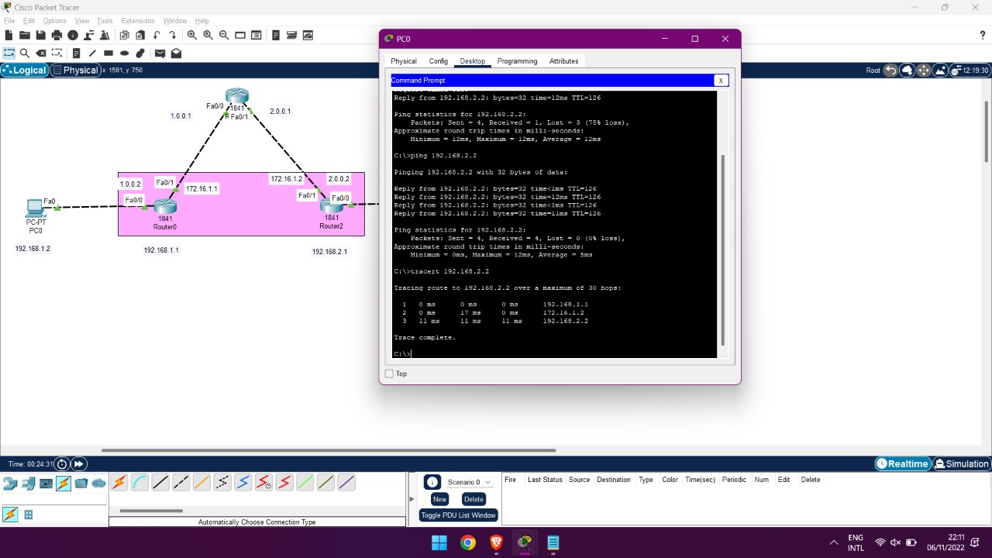
IMPLEMENTATION OF VPN USING CISCO PACKET TRACER

Slide 13
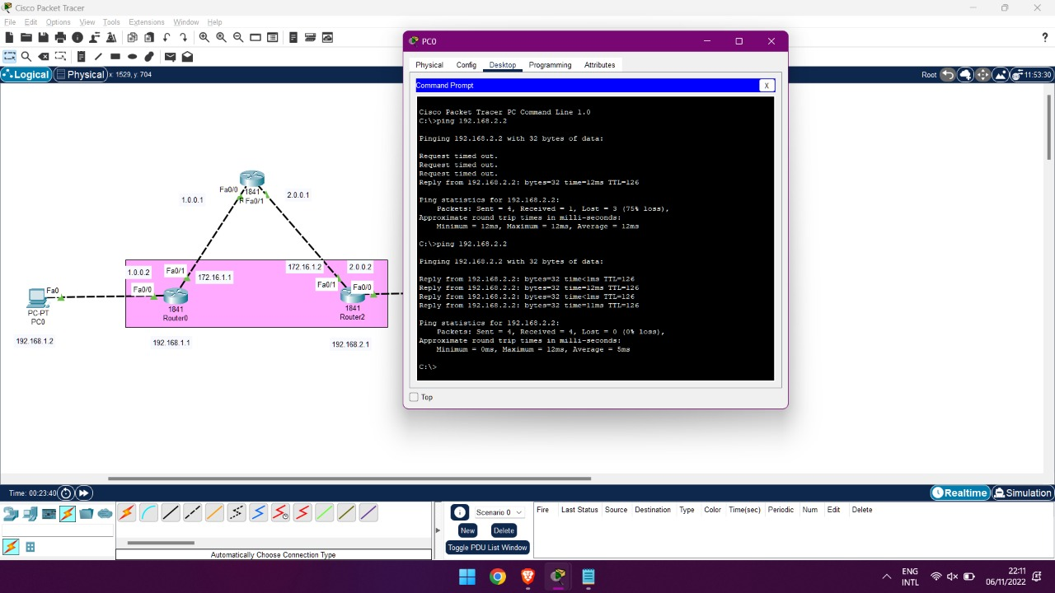
IMPLEMENTATION OF VPN USING CISCO PACKET TRACER

Slide 14
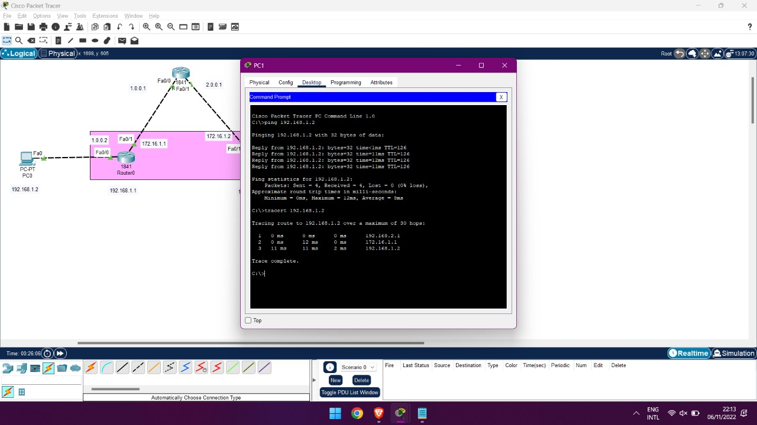
IMPLEMENTATION OF VPN USING CISCO PACKET TRACER

Slide 15
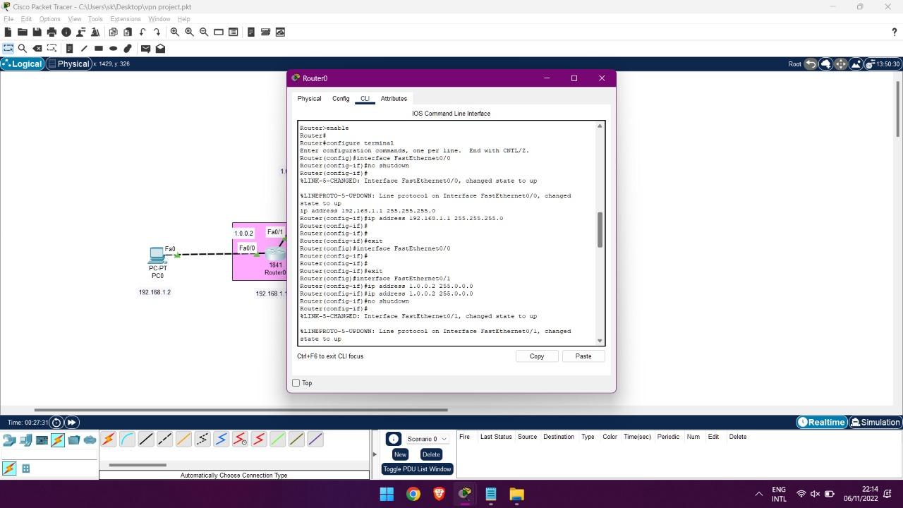
IMPLEMENTATION OF VPN USING CISCO PACKET TRACER

Slide 16
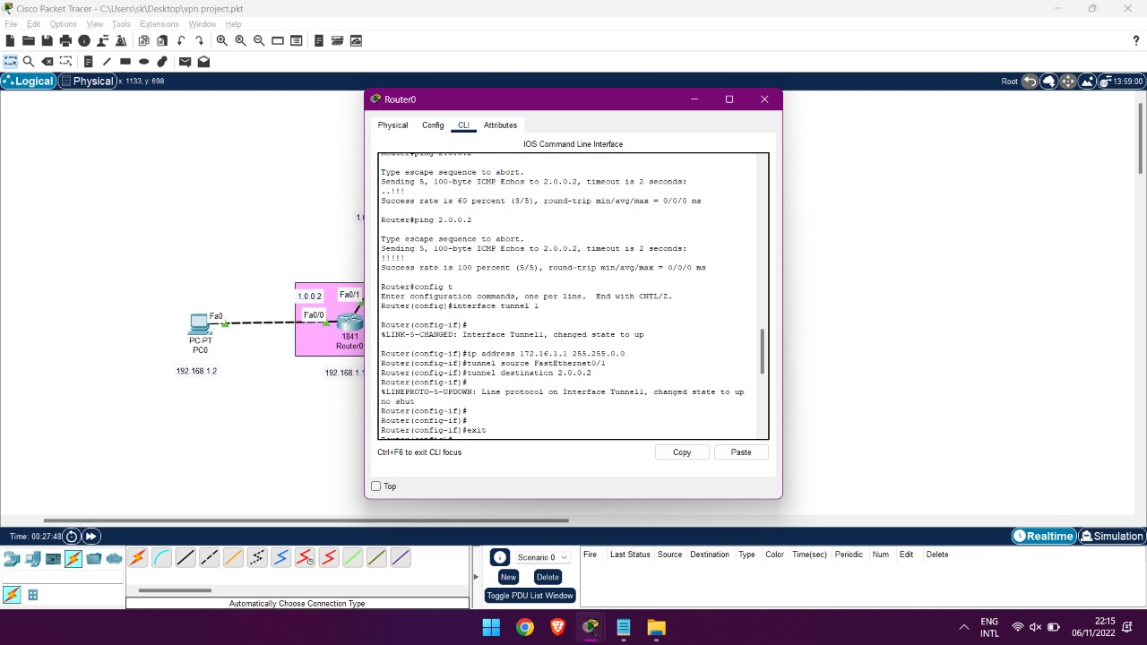
IMPLEMENTATION OF VPN USING CISCO PACKET TRACER

Slide 17
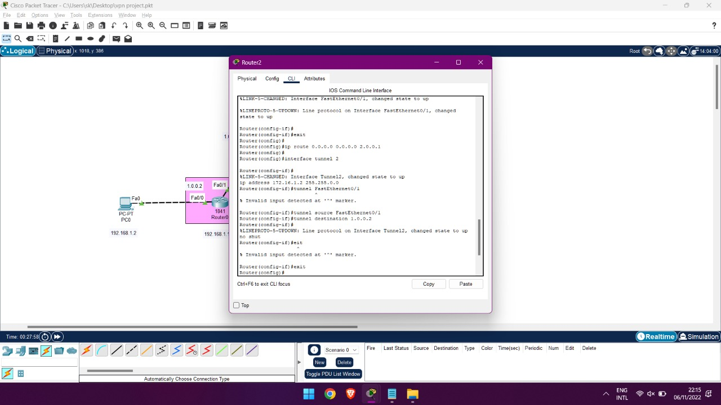
IMPLEMENTATION OF VPN USING CISCO PACKET TRACER

Slide 18
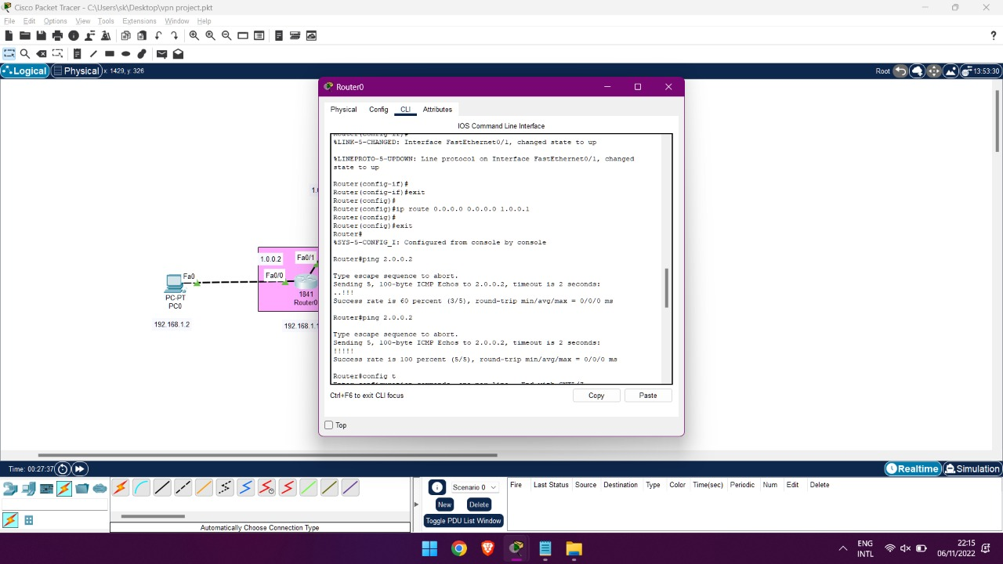
IMPLEMENTATION OF VPN USING CISCO PACKET TRACER

Slide 19
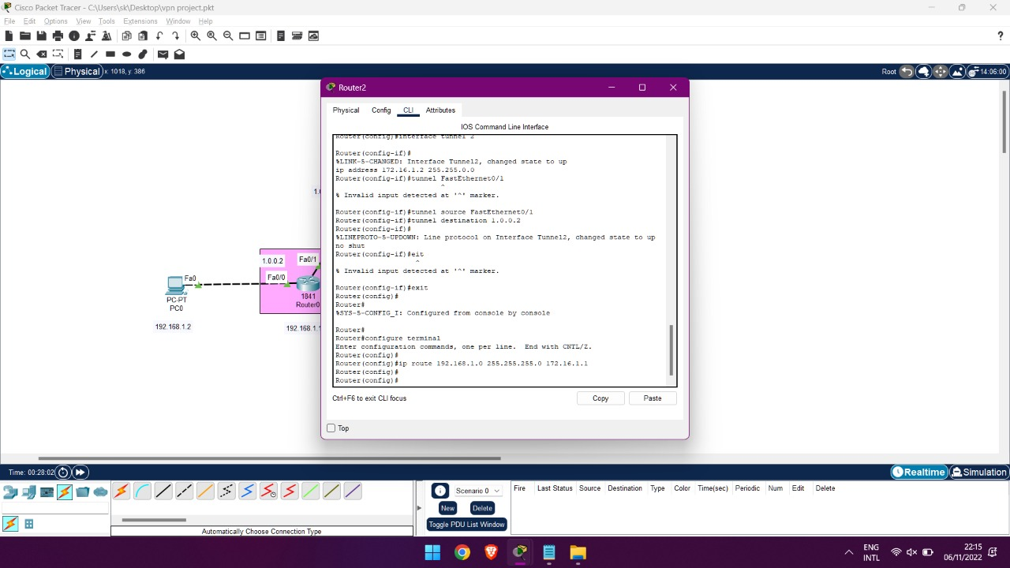
IMPLEMENTATION OF VPN USING CISCO PACKET TRACER

Slide 20
APPLICATION OF VPN
Uses for Business:
Keep Your Shared Network Secure. Using a VPN across your shared network will help ensure that business communications remain secure. It will also make your company less susceptible to cyber-attacks.
Connect to Public Wi-Fi Confidently. Nearly everyone connects to the free airport Wi-Fi during a layover or delay, but doing so leaves you wide open to potential theft. Using a VPN before opening that email or checking your account balance will help keep your data secure.
Browse Safely on Any Device. Securely connect to your business cloud, no matter your device. Since a VPN is encrypted and remotely hosted, you can log in from anywhere without the risk of a security breach.

Slide 21
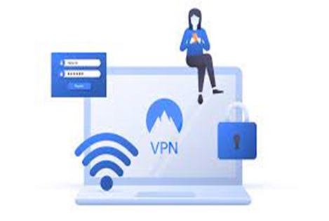
APPLICATION OF VPN
2. VPN Uses for Gaming
Play In Public Without Worry. It’s great to take advantage of free public Wi-Fi when you’re ready to play, but using an unsecured network carries risks. Keep your gaming devices safe by using a VPN.’
Protect Yourself From the Trolls. The stakes can get high in multi-player games and occasionally people overreact. Having a VPN protects your identity and IP address so that if you inadvertently upset someone, they are not able to track your location.

Slide 22
APPLICATION OF VPN
3. VPN Uses For Streaming
Watch Your Favorite Foreign Films. Some paid subscription streaming services implement “geo-blocking” technology. This means in some geographical locations, you’ll have restricted access to certain content. Using a VPN bypasses this issue and allows you to stream nearly anything you want to watch, no matter where you are.
Improve Buffering Issues. Since streaming services are so popular, it’s not unusual for the bandwidth to get overloaded and cause buffering issues. A VPN can help circumvent this, ensuring a smoother viewing experience.

Slide 23
LIMITATIONS OF VPN
While a VPN is a great tool to help separate your location (and in many ways, you) from your data, it doesn’t obscure everything about you. If you take a Facebook quiz or like a post on Instagram, the app you are using while connected to the VPN is still able to use your behavior to tailor in-app ads and content.
Similarly, if cookies are enabled on your computer, companies can follow you while you are on their site—and after. Your full data isn’t obscured with a VPN alone. Combining a VPN’s protection with Tor, an open-source tool that allows you to browse the web anonymously, and other security measures is necessary for fuller security.
VPNs aren’t perfect tools. Like any computer program, they are susceptible to malware and online attacks. If infected, a VPN’s security benefits are nullified.
The likelihood of attacks and security breaches is increased by using a free VPN service. To recoup their business costs, “free” VPN services may sell user data or run ads that could be infected with malware. If your goal is to increase your data privacy, then investing in a paid VPN is your best bet.

Slide 24
CONCLUSION
As we see from the explanation, a VPN (Virtual Private Network) is a network that is used to create a private scope of computer communications or to provide a secure extension of a private network over an insecure network such as the Internet.
It has its advantages and disadvantages but in the current world, it is found to be very helpful, especially for corporates.
We hope you understood the topic, and if you have any doubts, you may ask us.

Slide 25
BIBLIOGRAPHY
https://www.cs.ru.nl/bachelors-theses/2017/Stan_Derksen___4386388___Creating-a-secure-virtual-private-network-using-minimal-code.pdf
https://github.com/davlxd/simple-vpn-demo/blob/master/vpn.c
https://cybersecfaith.com/2020/11/01/setting-up-an-ipsec-vpn-using-cisco-packet-tracer/
https://www.youtube.com/watch?v=MqFORN01ckg
https://www.youtube.com/watch?v=jFH6kj9-s0w

Slide 26
THANK YOU!

